Slide 1
Using Pay-for-Performance Conservation to Address P Loss from Agricultural Land
Jonathan Winsten, Ph.D.
Winrock International
October 1st, 2020
Notes:
Ag economist
Working with Winrock since 2001
Been working on PFP around US and in Canada
Dad had a dairy farm
Live in Shelburne
VT Ag is important to me, as is Lake Champlain

Slide 2
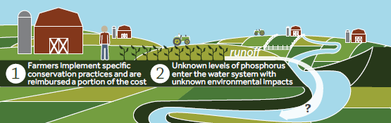
Current Approach:
“Pay-for-Practice” Conservation
USDA spends >$5 Billion/Year on practices
Field-specific outcomes are not quantified
Does not motivate farmers to solve problem
Notes:
2
Effectiveness is not monitored and largely unknown.
Pay-for practice made sense b/c nonpoint source pollution, that which does not come out of the end of a pipe, is very expensive to measure or monitor.
This approach does not motivate farmers.
It lacks clear goals
Farmers pay a % of the cost
It does not harness the farmers’ knowledge

Slide 3
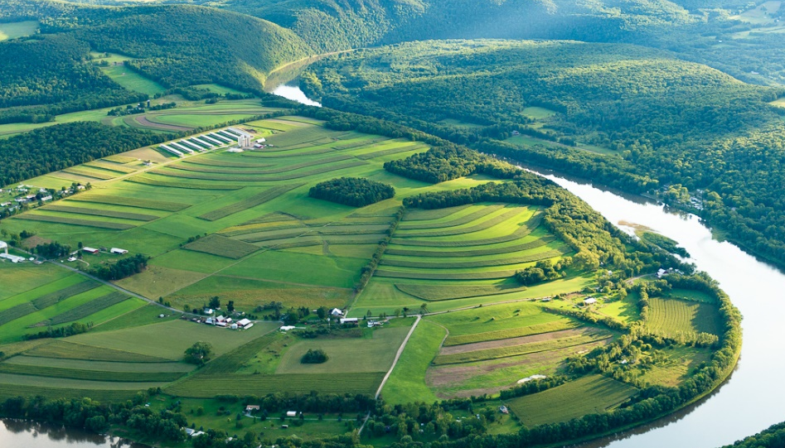
Landscape is Diverse:
BMP Performance is Highly Variable
Field-specific information is essential
Notes:
-Land is heterogeneous
-Practices will have significantly different impact on nutrient loading depending on where they are applied.
However, the perf of any given BMP will vary greatly across the landscape due to:
Slope
Soils
Proximity to surface water
Crop management system
Using an average becomes meaningless when variation is so great.

Slide 4
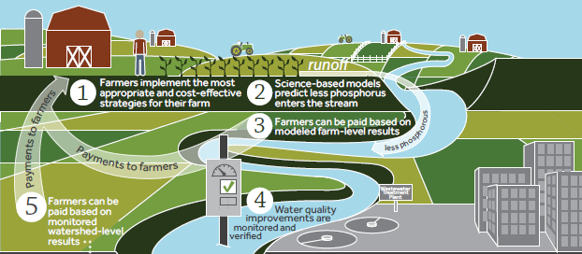

Alternative Approach:
“Pay-for-Performance” Conservation
Payments based on estimated outcome from specific fields
www.winrock.org
4
Notes:
4
New approach uses scientific advances in simulation modeling and outcome-based incentives.
Pays farmers for achieving nutrient reduction goals;
Farmers choose how to best reduce nutrient loss from their specific fields;
Incentivizes farmers to choose the most cost-effective actions BECAUSE becoming more cost-effective increases net farm income.

Slide 5
Why Pay-for-Performance?
Address market failure
Motivate farmers
  Create specific goals
  Increase farm profits
Quantify outcomes
Cost-effective outcomes more likely
Notes:
Markets imply the existence of prices
Producers and consumers use prices to make decisions

Slide 6
Key Program Design Questions:
What, How, and Where?
What ecosystem service(s) do we target?
How do we quantify environmental performance?
Where do we quantify environmental performance?
Need performance measures that are closely related to ultimate water quality concern AND directly influenced by farm management decisions.
Notes:
What: N, P, and/or Sediment?
How: Measurement or modeling?
Where: Edge of field, Stream, Mouth of watershed?

Slide 7
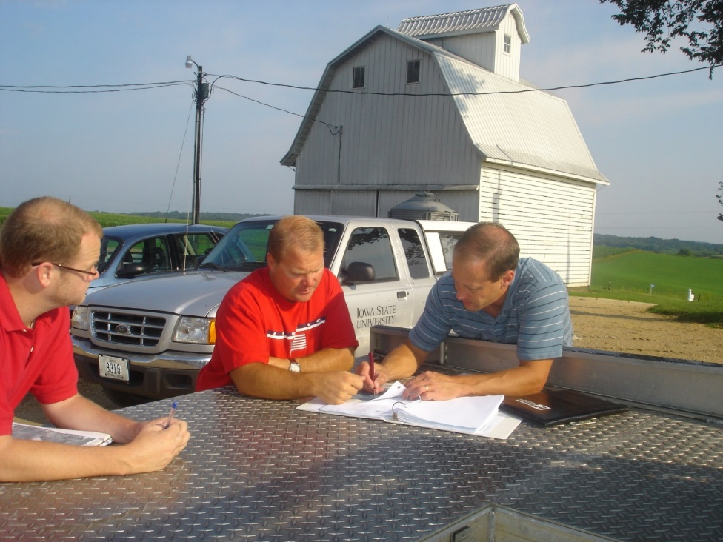
Work with Farmers to Help Develop Ideas and Provide Specific Information
Steps:
Identify actions for specific fields (scenarios)
Estimate nutrient loss reductions and costs
Provide information to farmers for decision-making
Notes:
7
We work with local partners who spend time with each participating farmer to:
collect needed information for each field
estimate the baseline level of loss
identify actions that could reduce nutrient loss and that the farmer is open to considering
We then use simulation models to calculate amount of nutrient loss reduction and the full economic cost to the farmer.
Farmer uses results, including amount of resulting incentive payment, to make informed business decisions about reducing nutrient losses. They are motivated to find and implement the most cost-effective actions.

Slide 8
Pilot-Testing Pay-for-Performance
Iowa, Vermont, Wisconsin, Ohio
    Focus on P loss; also N loss (Ohio)
Models: P Index, Snap-Plus, NTT
WQ Measurement (Ohio)
Ohio: Offering $35/lb P and $5/lb N

Slide 9
Information Created for Farmer Decision-Making
Graphs of field-specific:
  Nutrient loss reduction
  Payment
  Full economic cost
      Profit or loss
Table

Slide 10
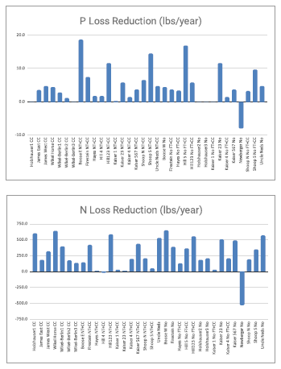
Provide Results to Each Farmer:
P and N Loss Reductions
      P reduction
      N reduction

Slide 11
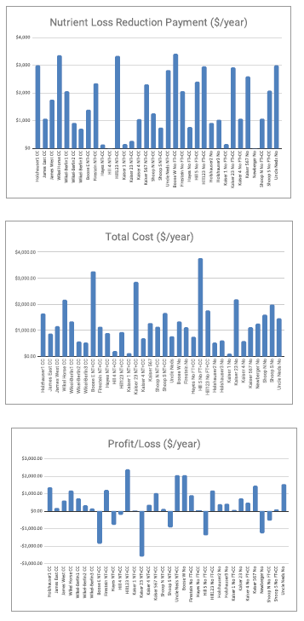
Provide Results to Each Farmer:
Payment, Cost, and Profit/Loss
      Payment
      Total cost
      Profit or loss

Slide 12
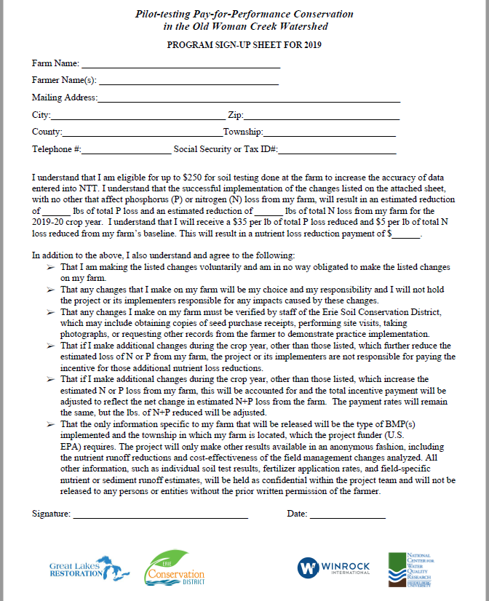
One-Page Sign-up Form
Ohio Project

Slide 13
Cost-effectiveness ($/lb P loss reduction) Scenario Results Across Vermont Farms
Notes:
Explain our PT project approach:
Use of VT P Index to quantify field-specific P loss.
Goal was to see if performance-based incentives could reduce P loss cost-effectively
Sought voluntary participation in selected watersheds
Needed to figure out an appropriate price, given budget constraint
On each farm, we:
brainstormed with producer about changes they would be willing to do if the price were right
ran scenarios through the P Index
calculated total costs for each change and cost per lb P reduced
Some of the farmers interested in participating were the most active conservationists
They had already picked the low-hanging fruit (did not have many cost-effective actions remaining)
We did not want to penalize them for being good stewards
We designed an alternative “stewardship” payment
Based on weighted average P loss per acre across the farm
If P loss<0.5 lbs/acre = $2/ac
If P loss<0.1 lbs/acre = $5/ac
All prices were based on our budget constraint
The technical- AND cost-effectiveness of BMPs varies greatly from farm-to-farm AND from field-to-field.
There is great variation across types of BMPS, as expected, but also for any given BMP.
Take the example of cover crops. In our Vermont pilot-testing, cover crops ranged from costing $29 to $842 per lb of P loss reduction.
The most cost-effective change was a fertilizer tweak. {Explain this change}. This is not that kind of change that our current programs incentive farmers to do, even though they can be done through some of the EQIP practice standards.

Slide 14
Cost-effectiveness ($/lb P loss reduction) Scenario Results Across Iowa Farms

Slide 15
Results of Good Business Decisions
Watershed | P Loss Reduced (lbs/acre/yr) | Farm Cost ($/lb P) | Farm Profit ($/lb P) | Sediment Loss Reduced (tons/acre/yr)
Iowa | 0.88 | -$0.61 | $10.61 | 1.58
Vermont | 0.26 | $4.86 | $20.14 | 1.01

Slide 16
Lessons Learned
Low-hanging fruit remains
Perf-based incentives inspire new ideas
Farmer motivation varies
Boots on the ground is essential
Transaction Costs < Program Benefits
Models: a necessary evil??
Policy change is slow
Notes:
16

Slide 17
“Model-at-the-farm, measure-at-the-watershed”
Notes:
17

Slide 18
Model at the Farm –
Measure at the Watershed
Modeling farm performance
  Triggers primary incentive payment
Measuring watershed performance
  Provides a focal point and real report card
  Triggers a secondary incentive payment
  Farmer-to-farmer peer pressure for participation
Winner of U.S. Nutrient Challenge (2015)

Slide 19

Pay-for-Performance Conservation:
A How-To Guide
Describes steps and data needs
Goals:
  Reduce transaction costs
  Create opportunities for scale
Funded by Great Lakes Protection Fund
https://www.winrock.org/project/running-off-pollution-paying-midwestern-farmers-to-improve-water-quality/

Slide 20
Contact Information
  Jon Winsten
  Senior Agricultural Economist
  Winrock International
  Email: jwinsten@winrock.org
  Tel: (802) 343-3037
Notes:
20

