Slide 1
Foundations of Energy and Matter
Climate and Community Resilience: Lessons from the Soil
March 22, 2020
Lauren Weston
laurenanneweston@gmail.com
Notes:
Cat Buxton and I are your presenters today in this first workshop of the series. We were on the planning team for the series and felt that we could frame the series well since we knew who else would be presenting and what they would be bringing to the sessions. I am presenting on some of the science of climate change, but I want to be clear that climate change is not just a scientific issue. It is a justice issue. It is a social, economic, and cultural issue that cannot truly be addressed through just more technology. We must, as a society, look critically at the systems we use that have gotten us here.
With that in mind, we chose speakers for this series who could speak towards lots of different aspects of climate and community resilience. Because of my particular background and the trust that I have that you will all come back for the next events to hear from those speakers, I am focusing today on the science-y side of things.
I have been working to better understand the earth and its systems, so that I can attempt to fathom some of the impacts that my choices and the choices of my community are having on the world. The content that I am presenting is some of what I’ve learned and felt might be useful to share with you all. I look forward to the new questions that come out of today and to continuing these discussions.
Alright, let’s get started with the Foundations of Energy and Matter and how they relate to climate change

Slide 2
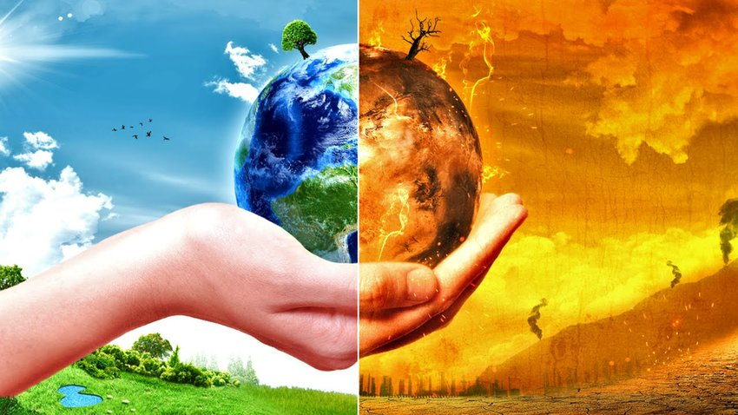
Climate and Climate Change
Climate: Long-term average of weather Weather: the way the atmosphere is behaving
Temperature
Pressure
Wind
Humidity
Precipitation
Cloudiness
Climate Change: Changes from the long-term average weather
Global Average Temperature Increase = “Global Warming”
Greenhouse gas cycle disruptions contribute
Atmospheric Pressure and Wind are the results of energy balances and distribution
Humidity, Precipitation, & Cloudiness changing
Water cycle (tied to energy dynamics) disruption
Climate change leads to conditions that fundamentally alter life as we know it for ourselves and other systems.
Notes:
Split screen climate change image: https://www.researchgate.net/profile/Muhammad_Saqib_Irshad/post/What_are_the_major_causes_for_climate_change_Serious_replies_please/attachment/5bb0990d3843b006753be32d/AS%3A676494112206848%401538300173076/image/maxresdefault.jpg
Climate is defined as the long-term average of weather. Weather is defined as the way the atmosphere is behaving. This includes components such as temperature, pressure, wind, humidity, precipitation, and cloudiness.
Therefore, climate change is changes from the long-term average of those components over an area - be it a town, a watershed, a bioregion, a continent, the entire world, or some other area.
When we talk about climate change, sometimes we talk about “Global warming”. That is one piece of this. Global warming means that the average overall temperature of the world on an annual basis is increasing due to an amplification of the greenhouse effect - we will get into more of that soon.
Other aspects of climate change involve disrupted energy distribution patterns. Air and water move energy around throughout the atmosphere, and when those movements change, climate changes.
When we talk about these ideas, we are talking about changes that fundamentally alter life as we know it on the planet. These changes impact habitat ranges and resource availability. We are experiencing mass migrations, mass extinctions, wars, economic collapses, and many other consequences of those changes.
So, let’s try to understand some of why this is happening.

Slide 3
Climate Change Concepts
Amplification of the Greenhouse Effect
Changes in Energy Distribution
Fundamentals of:
Matter
Energy
Radiation
Convection + Conduction
Latent Heat
Notes:
You’ll be seeing this slide a lot. It will serve as a table of contents to guide us through the presentation today. What it’s showing is a clearer summary of the previous slide, indicating that climate change is the amplification of the greenhouse effect and changes in energy distribution. In order to understand those ideas, we need to understand the fundamentals of matter and energy. We will dive into energy distribution by discussing the modes of energy transfer, which are radiation, convection and conduction, and latent heat.

Slide 4
Climate Change Concepts
Amplification of the Greenhouse Effect
Changes in Energy Distribution
Fundamentals of:
Matter
Energy
Radiation
Convection + Conduction
Latent Heat
Notes:
So, let’s start with Matter

Slide 5
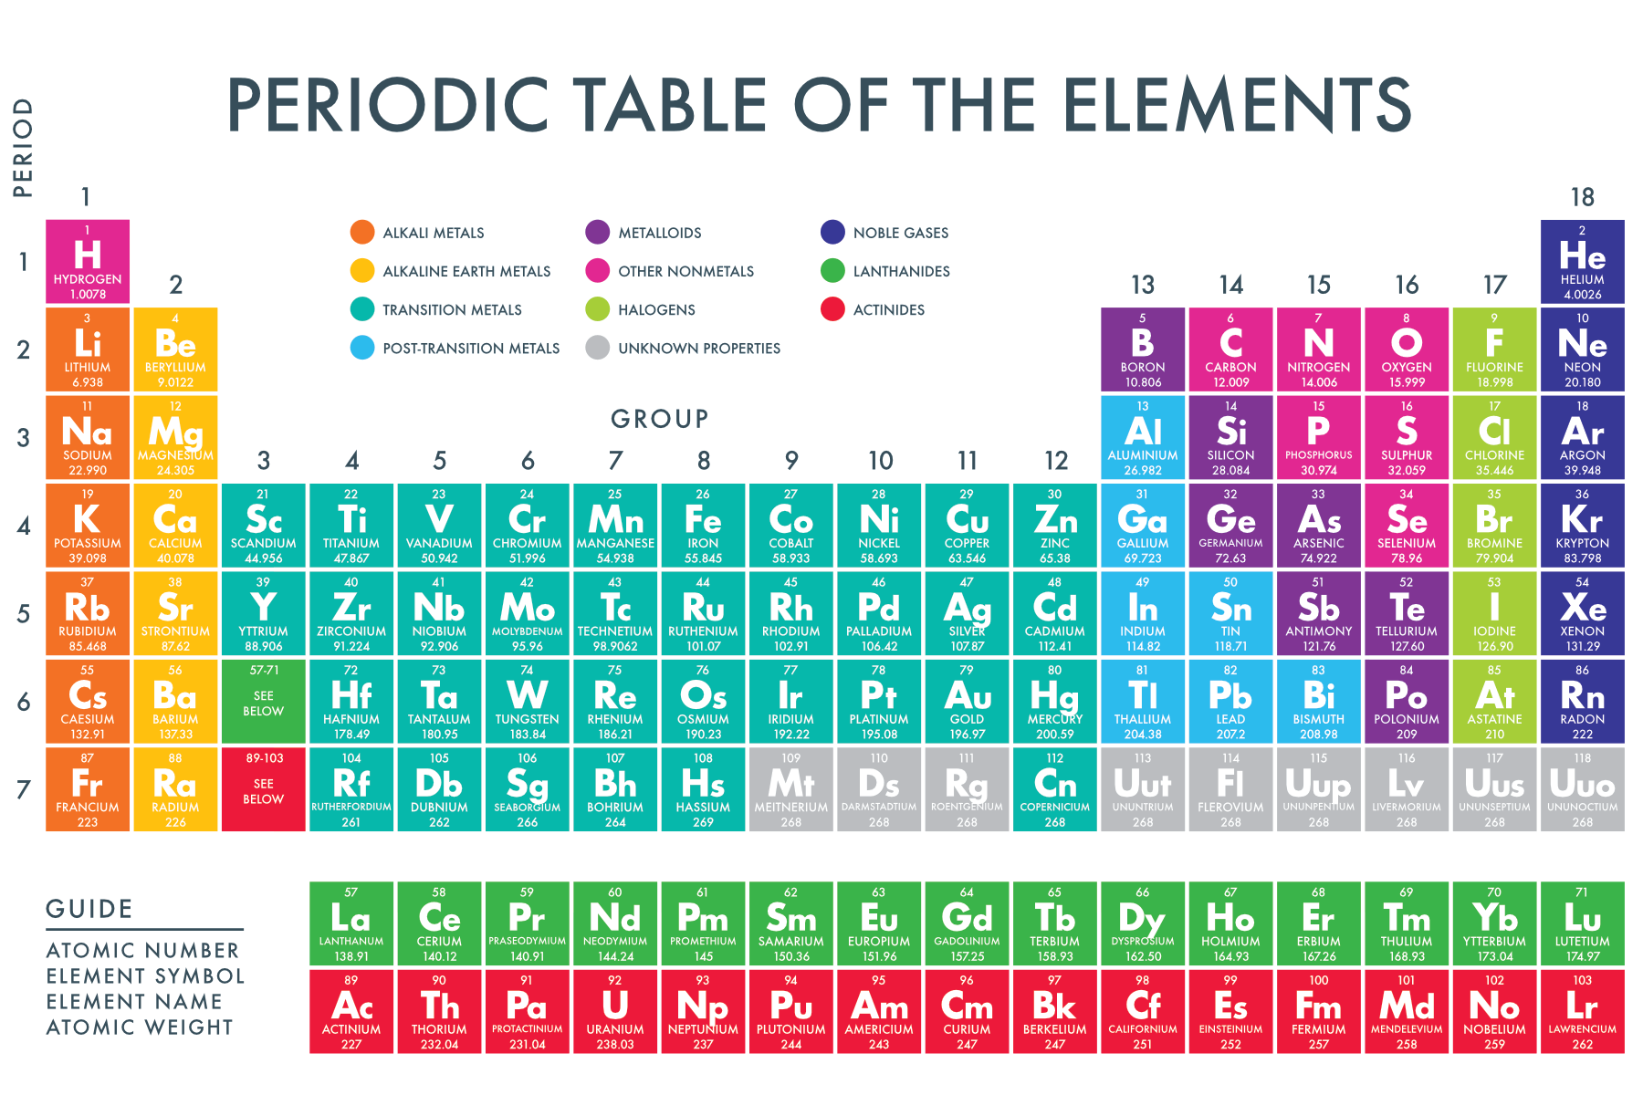
Matter
Earth is isolated regarding matter.
Therefore, it cycles throughout earth’s systems
Notes:
Periodic Table: https://i.pinimg.com/originals/77/99/82/779982d729b0e9eba48a072cb0f1894e.png
Big Bang Background: https://cdn.iveybusinessjournal.com/wp-content/uploads/2018/03/The-Big-Bang-Theory-of-Disruption.jpg
Sub-atomic particles https://i.ytimg.com/vi/l1VXM_b2KFY/maxresdefault.jpg
Rainbow Cycle: https://cdn.pixabay.com/photo/2018/05/02/14/57/arrows-3368751_960_720.png
Matter is the stuff that makes up earth’s systems. It’s every sub-atomic particle that makes up every atom, that makes up every molecule, that makes up every thing - air, soil, oceans, buildings, humans, plants, dogs, cats - every thing. Humans decided to name atoms based on how many protons are in the nucleus, so an atom with one proton is called hydrogen, with six protons is called carbon, an atom with eight protons is called oxygen, and there are obviously many others. Around the nucleus are electrons that we will talk a bit more about later when we get to radiation.
So where did all of this matter come from? There are many understandings of how the earth and its matter came to be, including various creation stories from indigenous cultures and religions around the world.
Current western scientific theory tells us that matter came from the big bang 13.7 billion years ago. In terms of earth, it left a cloud of cold dust particles, that, about 4.6 billion years ago, was disturbed and collapsed under the force of gravity to form our solar system, including our sun, the earth, and other planets that orbit our sun. Side note, there are at least 200 billion “suns” in our galaxy, the Milky Way, and there are millions of other galaxies in the universe. Just for some perspective.
Today, the earth functions almost completely as an isolated system in terms of matter - this means that there isn’t any new matter coming from outer space, barring the occasional asteroid, and we aren’t losing matter to outer space. This means that matter cycles through earth's systems - it doesn’t come and go from outer space, it just changes form and moves between earth’s own systems. This is a critical idea for understanding the carbon and water cycles that influence our climate - more on this later.

Slide 6
Climate Change Concepts
Amplification of the Greenhouse Effect
Changes in Energy Distribution
Fundamentals of:
Matter
Energy
Radiation
Convection + Conduction
Latent Heat
Notes:
Moving over now to the fundamentals of energy.

Slide 7
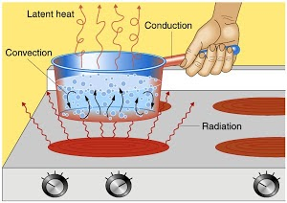
Energy
Energy: what is required for matter to change // the ability to do work
Four modes of energy transfer
Earth is NOT isolated regarding energy.
Instead, equilibrium provides some stability.
Energy In = Energy Out
Notes:
Pot: https://lh3.googleusercontent.com/proxy/4JH8GsU4lUz3C-Uy5FewsWuShyLKvU4_b0lLRioHzsznoXOh5DHyJJsLNLri1kT6XxrrifwjI2SFyyxfMVC35qINwKPx63KIShdemY0OkZ--bwJRkAsJSUodTWAQfKsO7YI=w1200-h630-p-k-no-nu
Scale: https://images.techhive.com/images/article/2014/07/scales-316888_1280-100355244-large.jpg
Energy is what is required for matter to change.
Now, unlike for matter, the earth is not isolated in terms of energy. There is a constant flow of energy in from the sun, and a constant flow of energy out of earth’s systems to outer space. Therefore, we are often concerned less with energy cycles and more with energy balances on a global scale. Meaning, we want to know that the amount of energy coming in is the same as the energy going out, otherwise we are gaining or losing energy and that means heating up or cooling down on a global scale - this can lead to global warming.
The modes of energy transfer are: radiation, conduction, convection, and latent heat.

Slide 8
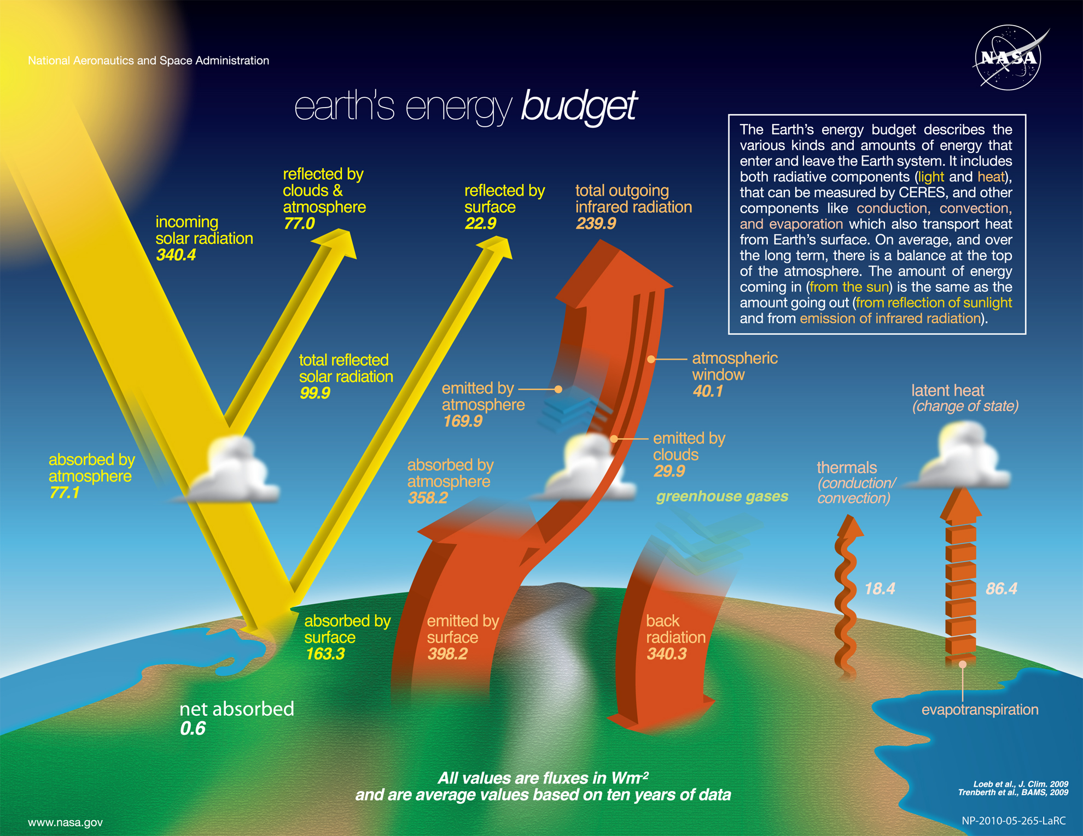
Notes:
Energy budget: https://upload.wikimedia.org/wikipedia/commons/b/bb/The-NASA-Earth%27s-Energy-Budget-Poster-Radiant-Energy-System-satellite-infrared-radiation-fluxes.jpg
Those modes are represented on this diagram here, which I’m sure you’ve all seen in one form or another before. This is the earth’s energy budget diagram from NASA that I think is really helpful for understanding these concepts because it breaks them down into pieces.

Slide 9
Outer Space
Atmosphere
Earth’s Surface
Notes:
Energy budget: https://upload.wikimedia.org/wikipedia/commons/b/bb/The-NASA-Earth%27s-Energy-Budget-Poster-Radiant-Energy-System-satellite-infrared-radiation-fluxes.jpg
I think what’s really critical to understand is that in any discussion about energy on earth, there are three systems or layers that we’re thinking about.
We’re thinking about outer space - what’s coming in from it (largely just from the sun) and what’s going out into it.
We’re thinking about the atmosphere - this region around the surface of the earth that extends away from the surface. According to NASA in 2017, the atmosphere extends up to 6,200 miles away from sea level. However, most of the mass of the atmosphere (75-80%) is in the troposphere which is the layer that we live in - the first 4-12 miles of the depending on latitude and season. This is also where our weather occurs. https://scied.ucar.edu/shortcontent/troposphere-overview
And then we’re thinking about the surface of the earth - meaning the land and oceans surfaces, meaning buildings, and trees, and farms, and mountains, and glaciers - everything that isn’t floating in the atmosphere.

Slide 10
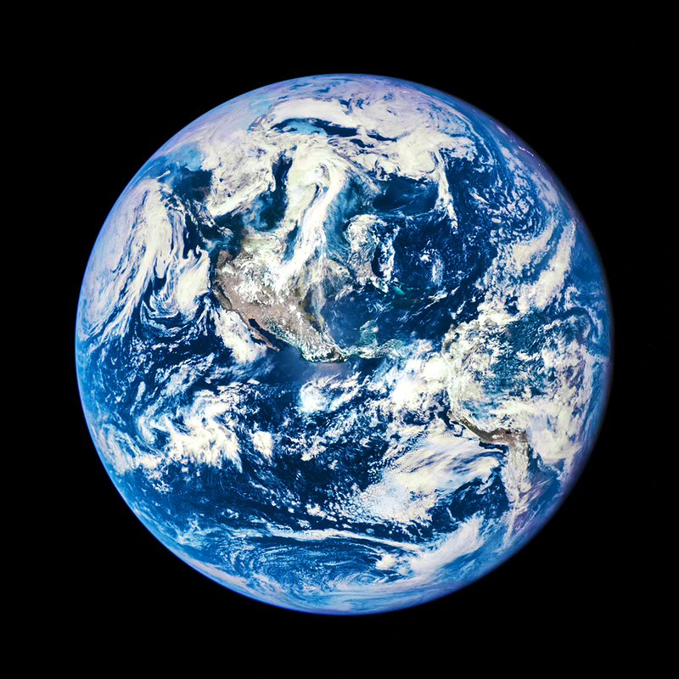
Outer Space
Atmosphere
Earth’s Surface
Atmosphere not to scale
Notes:
Earth: https://img.rawpixel.com/s3fs-private/rawpixel_images/website_content/pd36-1-gsfc_20171208_archive_e000678.jpg?w=800&dpr=1&fit=default&crop=default&auto=format&fm=pjpg&q=75&vib=3&con=3&usm=15&bg=F4F4F3&ixlib=js-2.2.1&s=9f3da94452f2cb79aeb44a47a87d1bca
Here is another way to visualize this idea - making sure we keep in mind that there are three different layers that are interacting with each other.

Slide 11
Climate Change Concepts
Amplification of the Greenhouse Effect
Changes in Energy Distribution
Fundamentals of:
Matter
Energy
Radiation
Convection + Conduction
Latent Heat
Notes:
Now, getting to how energy moves between these three layers, let’s start with Radiation.

Slide 12
Outer Space
Atmosphere
Earth’s Surface
Notes:
Energy budget: https://upload.wikimedia.org/wikipedia/commons/b/bb/The-NASA-Earth%27s-Energy-Budget-Poster-Radiant-Energy-System-satellite-infrared-radiation-fluxes.jpg
As you can see here, radiation is the major mode of energy transfer when we’re talking about the earth’s energy budget. All of those boxes represent a specific component of radiative exchange. The other two on the far side of the diagram will be discussed later.

Slide 13
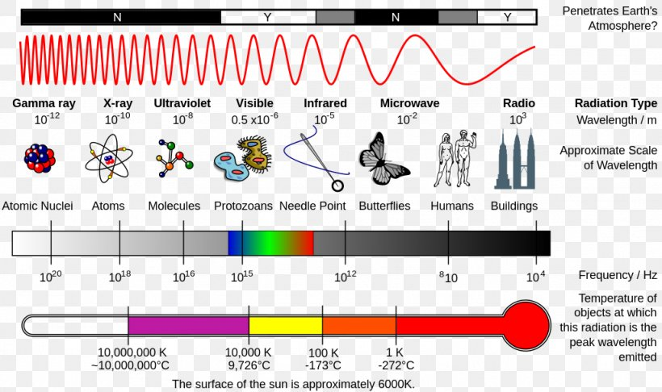
Radiation
Notes:
Radiation types:
https://www.google.com/url?sa=i&url=https%3A%2F%2Ffavpng.com%2Fpng_view%2Flight-rays-light-electromagnetic-spectrum-electromagnetic-radiation-png%2FaP4Bpx7Y&psig=AOvVaw19v3oA9BOFOM4-6H9cVBxR&ust=1584641210197000&source=images&cd=vfe&ved=0CAIQjRxqFwoTCKDVg9rOpOgCFQAAAAAdAAAAABAb
So, what is radiation - well…. It is radiant energy. It is transferred by photons, which are discrete bundles of electromagnetic energy that travel at the speed of light and behave both as particles and waves. All things with a temperature above absolute zero constantly radiate energy. Radiation is still a subject of intense study and it can be hard to wrap our heads around.

Slide 14
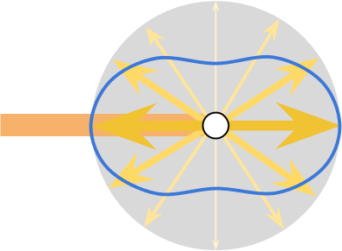
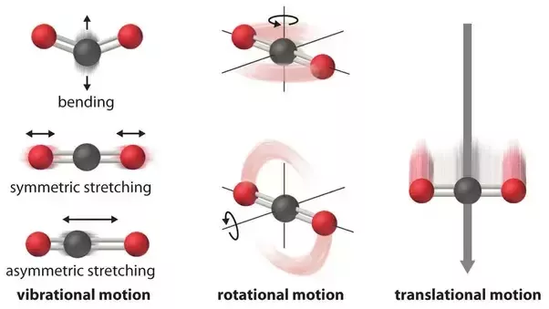
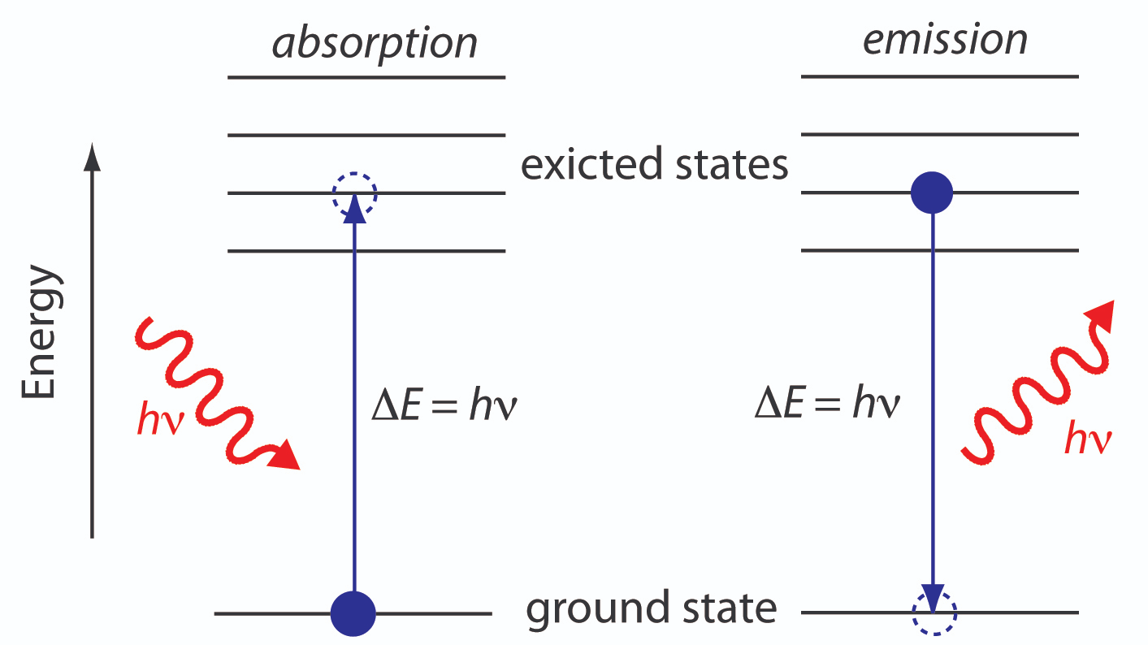
Radiation
excited
Notes:
Excited states diagram: https://d2jmvrsizmvf4x.cloudfront.net/hk2YSaihRmiCPKMwF8AF_Figure10.04.jpg
Motion diagram: https://qph.fs.quoracdn.net/main-qimg-37563ba53a9c483a24d9b4ab70b49d9d.webp
Arrows scattering: https://www.alanzucconi.com/wp-content/uploads/2017/09/scattering_13.png
So for us, we’re curious about the ways that radiation interacts with matter. On a molecular level, it can be absorbed, emitted, or scattered in different directions. The arrangement of the electrons and nuclei within the molecules determines what will happen to a photon of radiation of a given wavelength. This is the crux of the greenhouse effect, but more on that later.
When radiation interacts with a material, on a larger scale now, we talk about what percent is absorbed, reflected, and transmitted - together these three components add up to 100%.
Absorption increases the internal energy of the matter by exciting electrons and impacting chemical bonds. This can increase temperatures because temperature, after all, is just the average kinetic motion energy of the molecules. Reflection is when the matter scatters the radiation back in the direction it came from. On a global scale for solar radiation, we call this albedo. Transmission is scattering of the radiation along its original trajectory forward.
Transmission leads to something called “windows” where the majority of radiation of certain wavelengths passes through.

Slide 15
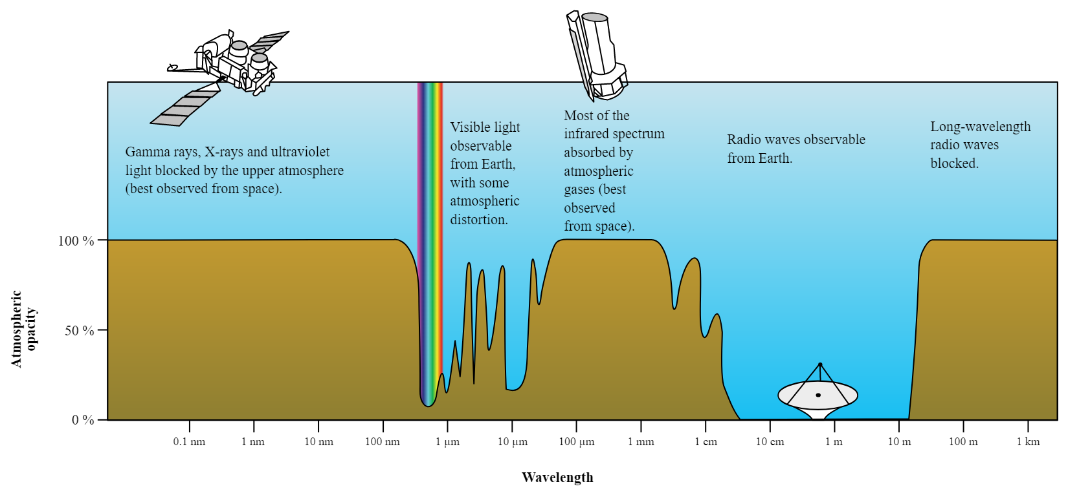
Notes:
Atmospheric Opacity image: https://upload.wikimedia.org/wikipedia/commons/3/34/Atmospheric_electromagnetic_opacity.svg
In earth’s clear atmosphere, we have “windows” around the wavelengths of radiation in the visible light range from the sun, where the rainbow is shown, between 8 and 14 micrometers from the earth further over, and in the range of radiowaves.

Slide 16
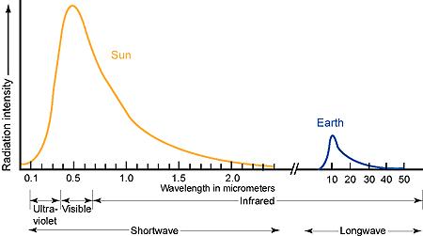
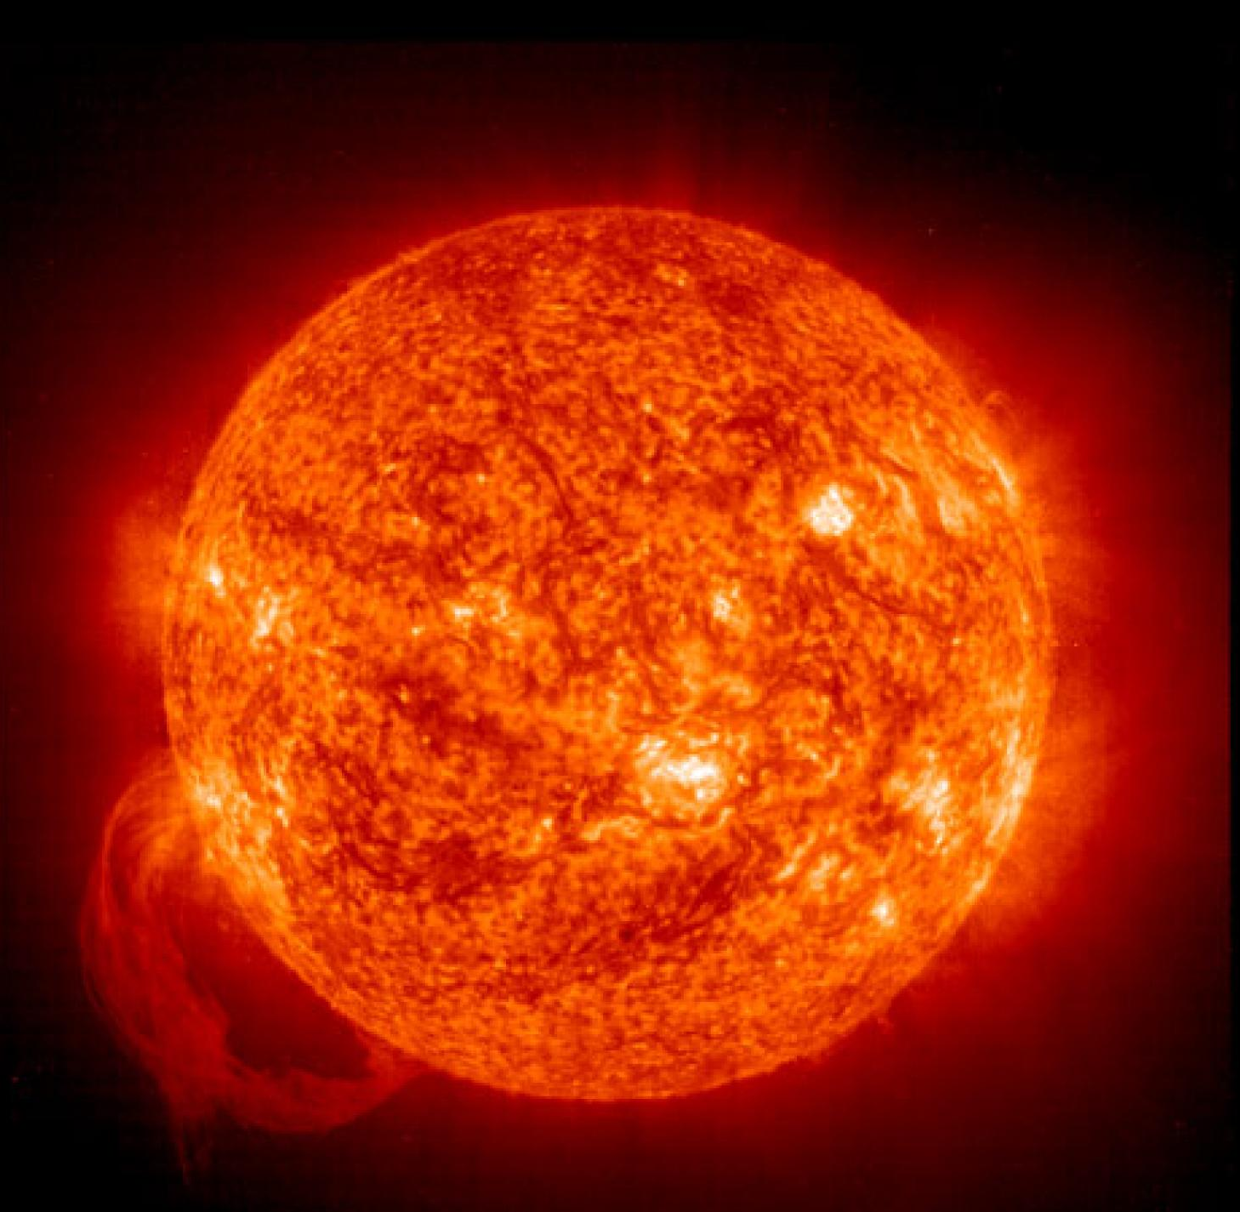
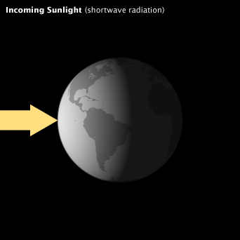
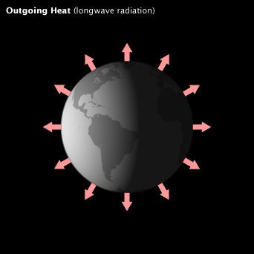
Radiation
& Earth
Notes:
Graph: https://www.google.com/url?sa=i&url=http%3A%2F%2Fagron-www.agron.iastate.edu%2Fcourses%2FAgron541%2Fclasses%2F541%2Flesson03b%2F3b.1.html&psig=AOvVaw0Lj7g-DIljhMXkd9s1ogih&ust=1584712408012000&source=images&cd=vfe&ved=0CAIQjRxqFwoTCPjMvfTXpugCFQAAAAAdAAAAABAD
Burning sun: https://www.nationalgeographic.com/content/dam/science/photos/000/065/6594.ngsversion.1509199314694.adapt.1900.1.jpg
Incoming sunlight: https://earthobservatory.nasa.gov/ContentFeature/EnergyBalance/images/global_energy_budget_in.png
Outgoing Heat:
https://earthobservatory.nasa.gov/ContentFeature/EnergyBalance/images/global_energy_budget_out.png
So let’s talk about radiation in the three layers we were talking about earlier: outer space, the atmosphere, and the surface of the earth.
In outer space, the sun is sending radiation away from it in all directions. Our earth happens to be in the pathway of some of that radiation - which is great for us. The earth’s atmosphere interacts with the radiation from the sun in all of the ways I mentioned before. Some of this radiation gets absorbed by the atmosphere and the earth’s surface, causing them to warm up.
They warm up, but they don’t get as hot as the sun, thankfully. Because of this temperature difference, the average temperature of the sun is about 10,000 degrees fahrenheit and the average temperature of the earth is about 58 degrees fahrenheit, the wavelength and total amount of radiation coming from these two entities is very different. That’s what is being shown on the chart on the upper corner. The sun gives off more radiation than the earth, think about the area under the curve as the total amount. And the sun gives off most of its radiation in the wavelength range from 0.1 to about 3 micrometers. Whereas the earth gives off most of its radiation in the range of 8 to 20 micrometers and longer. For this reason, we generally refer to the radiation from the sun (solar radiation) as shortwave; and the radiation from the earth (terrestrial radiation), as longwave.

Slide 17
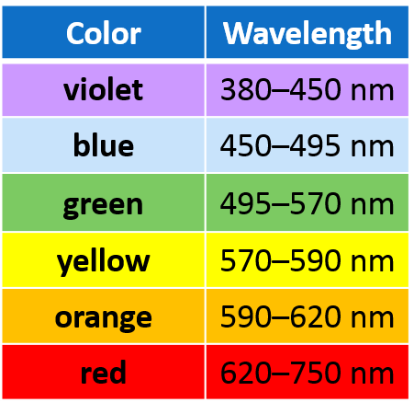
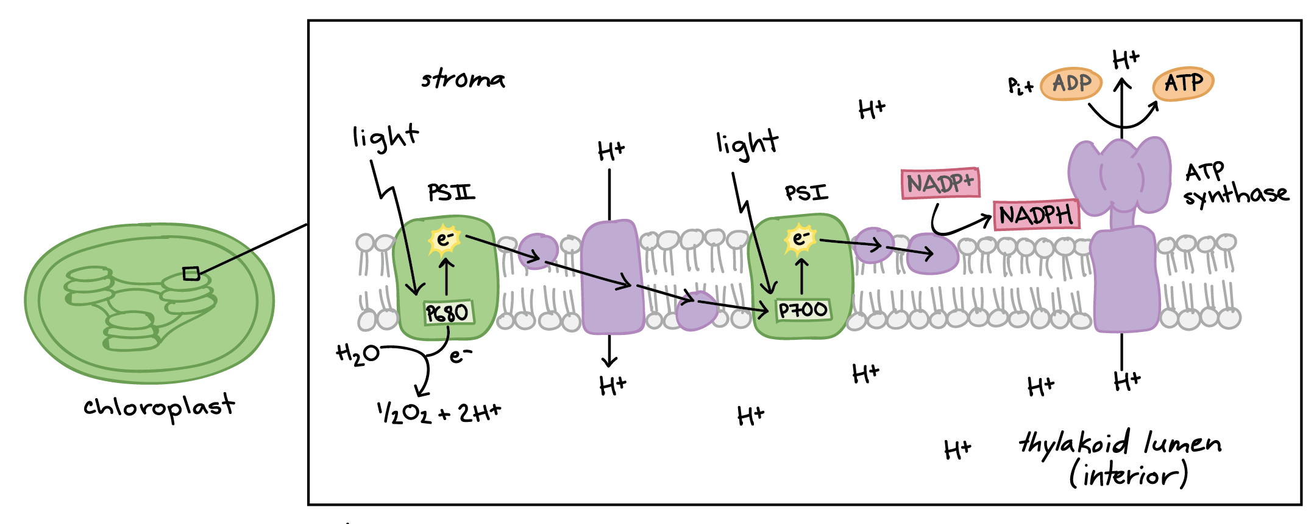
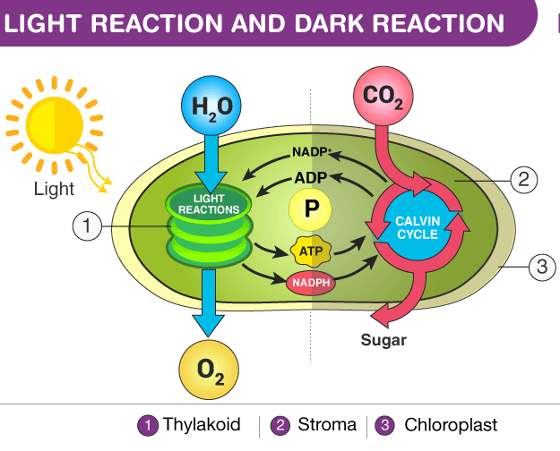
Photosynthesis
Notes:
Background seedlings: https://d3i6fh83elv35t.cloudfront.net/static/2019/07/roots_AdobeStock_94039247-e1563378322834-1024x652.jpeg
Linear reaction chain: https://cdn.kastatic.org/ka-perseus-images/faeb1179a538a3a8106fa5f3b9bd90c92f9834a7.png
Light reaction and dark reaction: https://cdn1.byjus.com/wp-content/uploads/2019/04/Light-reaction-And-Dark-reaction.png
Color Table: https://qph.fs.quoracdn.net/main-qimg-6eefcd4f1c120f55521f1fbccca5812f
Focusing for a moment on shortwave radiation from the sun, let’s detour into photosynthesis. The wavelength of radiation from the sun that gets through the atmosphere and reaches earth’s surface is largely in the visible light range - we call it visible because the human eye has evolved to be able to differentiate the wavelengths in this range and has associated them with different colors for our brains that we call red, blue, green, etc. Luckily, plants have also evolved to be able to use this range of wavelengths to their advantage.
The chlorophyll molecules in chloroplasts absorb visible light strongly in the blue and red wavelength bands, and less so in the green band, that’s what’s reflected for our eyes to see. The absorbed radiation causes electrons in the chlorophyll to get excited and trigger a chain of reactions that produces sugars or carbohydrates that get used by plants to build their cells. They also get sent out through roots to feed the soil life underground. Cat will talk a bit more about these root exudates and the soil food web later.
It is fascinating to think about how fundamental radiation is for life on earth.

Slide 18
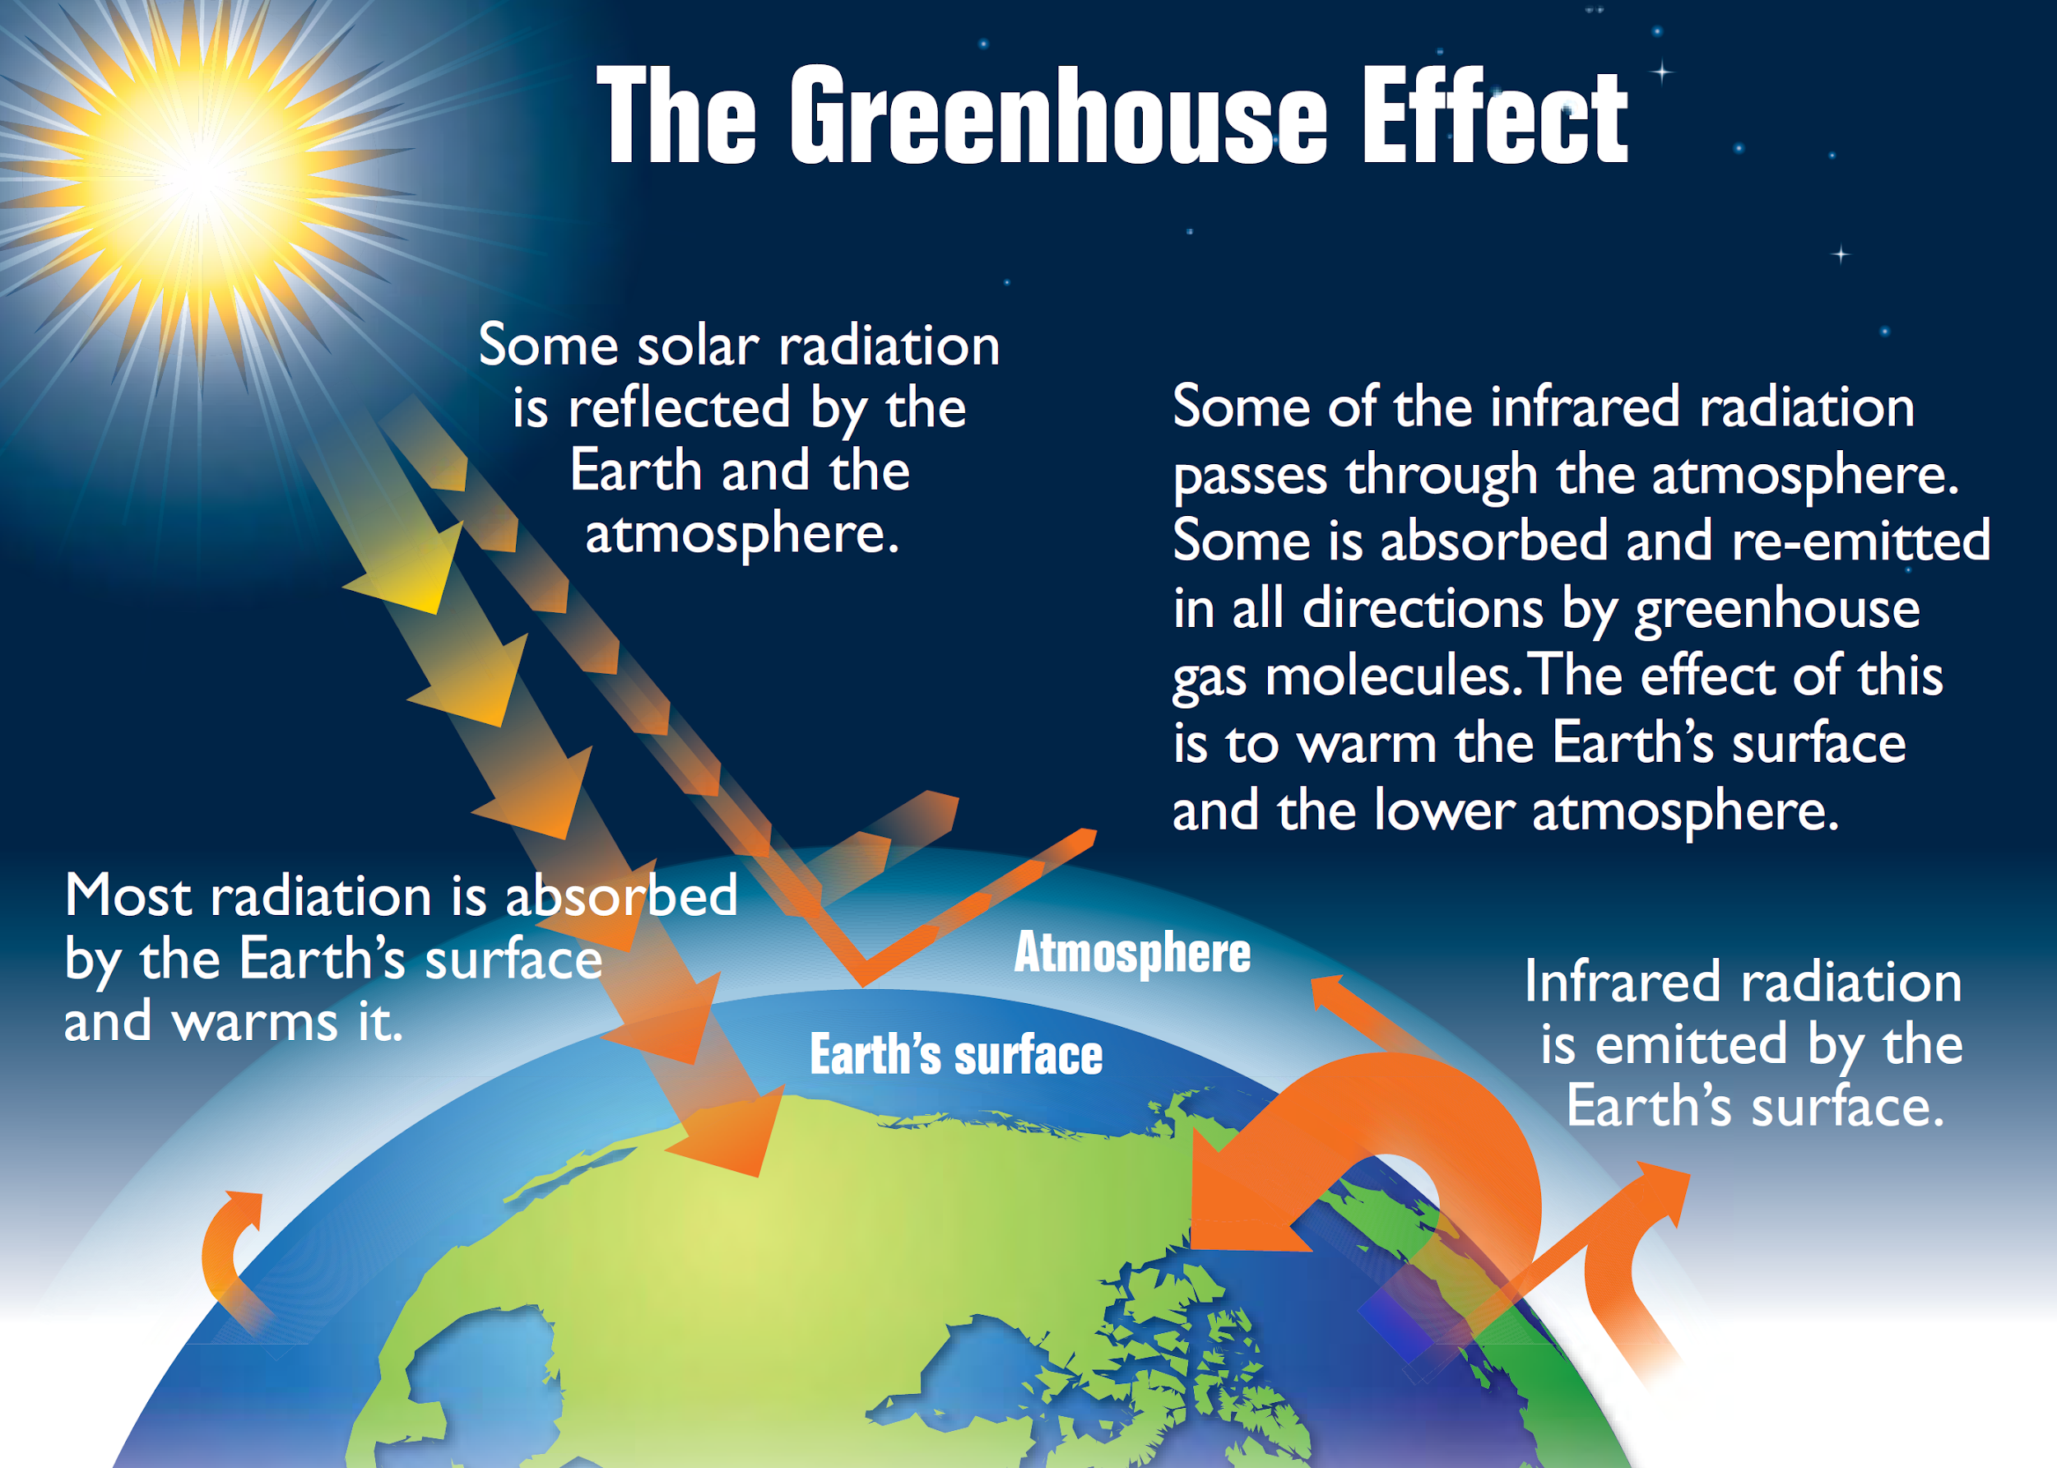
Terrestrial Radiation
Notes:
Greenhouse effect: https://upload.wikimedia.org/wikipedia/commons/8/8e/Earth%27s_greenhouse_effect_%28US_EPA%2C_2012%29.png
Along that same line of thinking, the fact that different molecules interact with certain wavelengths differently is also key to making our planet habitable by maintaining a temperature suitable for life. With this I am referring to the greenhouse effect. Without the greenhouse effect, the average temperature of our planet would be near 0 degrees fahrenheit.
The greenhouse effect is a result of the fact that the gases in the atmosphere transmit shortwave radiation through to heat the earth, but some of them reflect longwave radiation coming from the earth in all directions, including back down towards the earth - this is reflection back towards us, effectively trapping some of the longwave radiation and keeping the energy from being released to outer space.
Most of the gases in the atmosphere don’t interact with longwave radiation in this way, only greenhouse gases do. Depending on location and time of day, the atmosphere is made up of 0 to 4% water vapor, which is the most abundant greenhouse gas by far. And then about 0.1% of the atmosphere is made up of a combination of other greenhouse gases like carbon dioxide, methane, nitrous oxides, fluorinated carbons, and ozone. These gas molecules are well-suited to perform this task to keep the planet habitable.

Slide 19
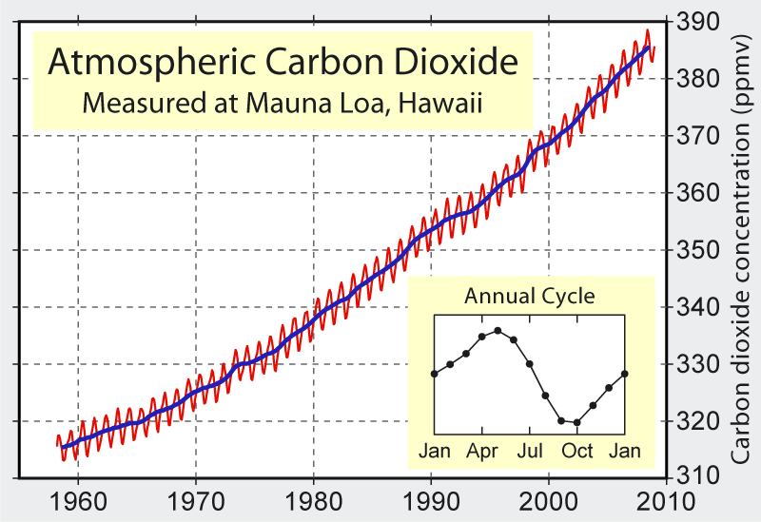
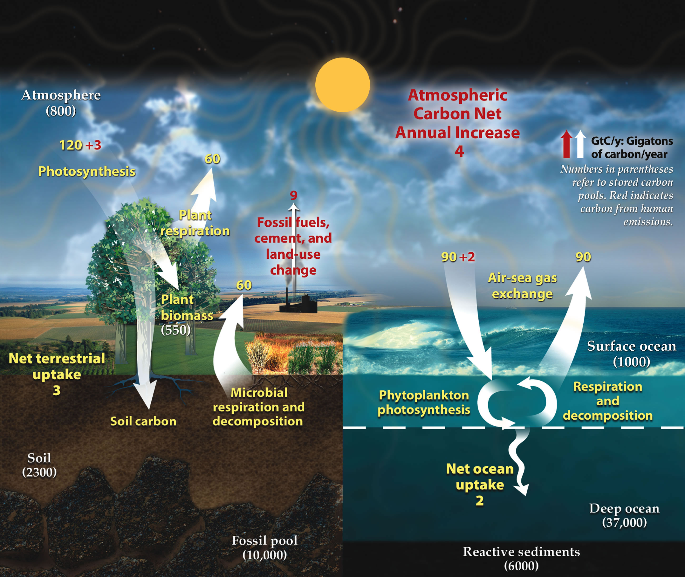
Carbon
Carbon Cycle Impacts
Fossil Fuels
Vegetation
Soil Carbon
Notes:
Terrestrial and ocean cycles: https://upload.wikimedia.org/wikipedia/commons/d/d5/Carbon_cycle.jpg
CO2 Graph: https://upload.wikimedia.org/wikipedia/commons/8/88/Mauna_Loa_Carbon_Dioxide.png
However, getting back to climate change. The carbon dioxide argument often made is that humans have disrupted the carbon cycle to the point that more carbon dioxide molecules are in the atmosphere than ever before. This, therefore, amplifies the greenhouse effect and changes the earth’s energy balance - causing the earth to warm.
A few nuances here that I find critical. Humans have increased the amount of CO2 in the atmosphere, but, thinking back to matter in earth’s systems, the actual total amount of carbon on earth hasn’t changed - we’ve just changed the way carbon cycles. Carbon that used to be in the ground as fossil fuels, in vegetation for most of the year as biomass, and in soils as organic matter is now in the atmosphere because of our power plants, engines, and agricultural and land management practices.
Another detail is that the carbon dioxide levels in the atmosphere are not just constantly increasing every day. I know we all hear that the levels are up to 415 parts per million, when a safe level might be 350. But just keep in mind that those numbers are the annual averages of the CO2 levels in the atmosphere. Over the course of the year, carbon dioxide levels in the atmosphere go down during the time period when it is summer in the northern hemisphere. This is because the majority of the terrestrial land mass on Earth is in the northern hemisphere and the summer is the growing season for most of our species of vegetation, including what we farm for food. This means that the photosynthesis on planet earth is working its hardest to take some of the carbon dioxide from the atmosphere and transform it into biomass.
And one more detail, the oceans, in addition to the atmosphere, have been carrying a large portion of the carbon that is no longer found in terrestrial ecosystems. Earth’s oceans have absorbed about 31% of our carbon emissions since the industrial revolution. https://www.ncei.noaa.gov/news/global-ocean-absorbing-more-carbon
This means that if the world does figure out a way to reduce the concentration of carbon in the atmosphere, the carbon stored in the ocean will begin to be released back into the atmosphere, lengthening the timeline to reestablish a carbon cycle that doesn’t amplify the greenhouse effect.

Slide 20
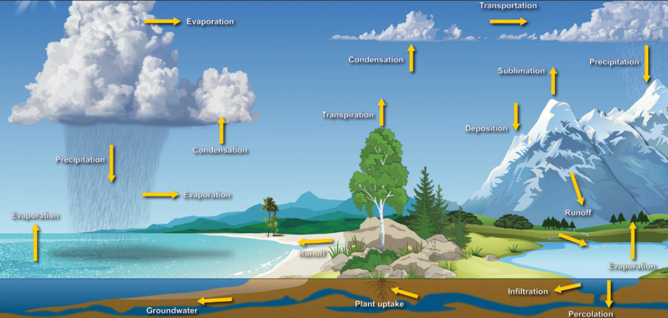
Water
Notes:
Water Cycle: https://www.noaa.gov/sites/default/files/styles/scale_crop_1120x534/public/thumbnails/image/watercycle_rc.png?itok=CcUyhuxd
So, that was the carbon cycle, but there’s also this other major thing called the water cycle. And, we’ve disrupted that pretty well too. Don’t forget, water vapor is the most abundant greenhouse gas and so changes to the water cycle also strongly impact the greenhouse effect. Just a few of the ways we’ve altered the water cycle include: removing vegetation which disrupts the soil-plant-atmosphere continuum that moves water through transpiration; the extraction of water resources from underground aquifers to bring that water into our fields; channelizing our rivers and stormwater paths to move water off the land and out of cities into the oceans as quickly as possible; paving and covering soil which reduces infiltration, and we’ve added particles to the atmosphere that change the way clouds form and precipitate. We will come back to the water cycle soon to dig in a bit more, but I am bringing it up here because people often forget about the water vapor component of the greenhouse effect.

Slide 21
Climate Change Concepts
Amplification of the Greenhouse Effect
Changes in Energy Distribution
Fundamentals of:
Matter
Energy
Radiation
Convection + Conduction
Latent Heat
Notes:
Okay, so, that was our overview into radiation. Big, complex, mode of energy transfer that drives a lot of the energy balance on earth. But, let’s not forget about these other modes.

Slide 22
Climate Change Concepts
Amplification of the Greenhouse Effect
Changes in Energy Distribution
Fundamentals of:
Matter
Energy
Radiation
Convection + Conduction
Latent Heat
Notes:
Conduction, Convection, Radiation: https://qph.fs.quoracdn.net/main-qimg-e59f15f458c2eb5a79acfe9cc2ee3ebd.webp
Conduction and convection involve the movement of sensible heat, or heat that, when moved to a new substance, causes the temperature of that substance to increase - you can sense or feel it. Conduction is the transfer of heat by direct contact on a molecular scale; when heat energy moves from molecule to molecule as a result of molecular collisions from vibrations - like in the image when your hand touches a hot pan. Convection is the transfer of heat by the mass movement of a fluid - a fluid is a liquid or a gas - and here we’re talking about the billions of molecules scale. The circulation of water in a pot of boiling water demonstrates convection.

Slide 23
Atmosphere
Earth’s Surface
Notes:
Earth’s energy budget: https://upload.wikimedia.org/wikipedia/commons/b/bb/The-NASA-Earth%27s-Energy-Budget-Poster-Radiant-Energy-System-satellite-infrared-radiation-fluxes.jpg
In Earth’s energy balance, conduction and convection move energy between the earth’s surface and the atmosphere.

Slide 24
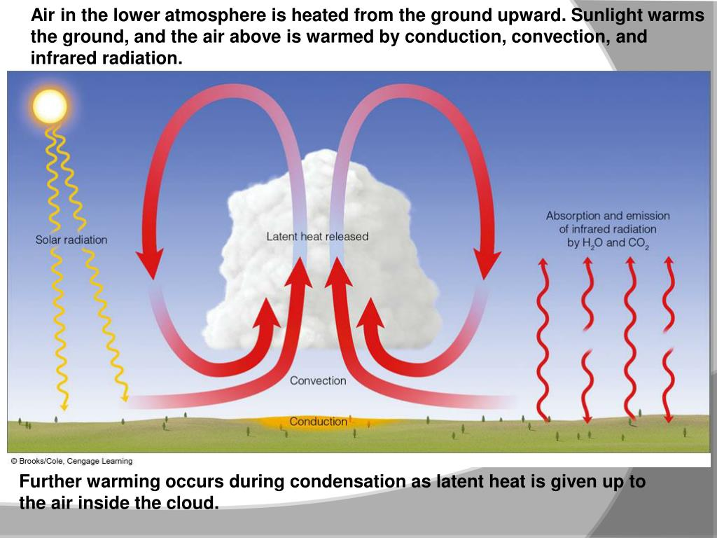
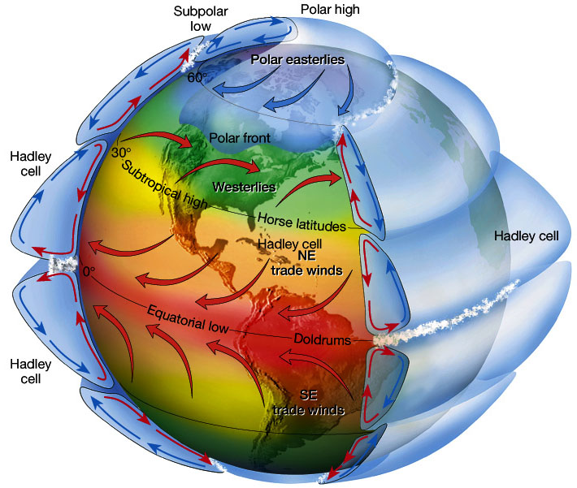
Heat Dynamics
Notes:
Cloud diagram: https://image.slideserve.com/200416/slide1-l.jpg
Global cells: https://www.climatetheory.net/wp-content/uploads/2012/05/Convection-cells.jpg
For this piece, solar radiation comes through the atmosphere and heats the surface of the earth. Then, the molecules in the air immediately above the surface of the earth get heated by conduction - the air molecules are touching the warm ground molecules. Those air molecules then move as an air parcel away from the surface of the earth because they are warm and want to cool off by spreading out and getting away from the heat source - this motion forces other air molecules downward toward the earth's surface, and this cyclical motion is known as convection.
Because the sun’s radiation is not evenly distributed across the surface of the earth due to the earth's rotation, albedo, and the angle of incidence of the sun, the radiation, conduction, and convection patterns are different at different locations which drive pressure gradients, wind, and storms - things we call weather patterns.
Now, maybe you’ll have noticed that this upper diagram shows latent heat release too. We’ll address that now.

Slide 25
Climate Change Concepts
Amplification of the Greenhouse Effect
Changes in Energy Distribution
Fundamentals of:
Matter
Energy
Radiation
Convection + Conduction
Latent Heat
Notes:
So again, latent heat is another mode of energy transfer.

Slide 26
Atmosphere
Earth’s Surface
Notes:
Earth’s Energy Budget: https://upload.wikimedia.org/wikipedia/commons/b/bb/The-NASA-Earth%27s-Energy-Budget-Poster-Radiant-Energy-System-satellite-infrared-radiation-fluxes.jpg
It involves the water cycle and clouds and it is the last piece of our energy budget analysis.

Slide 27
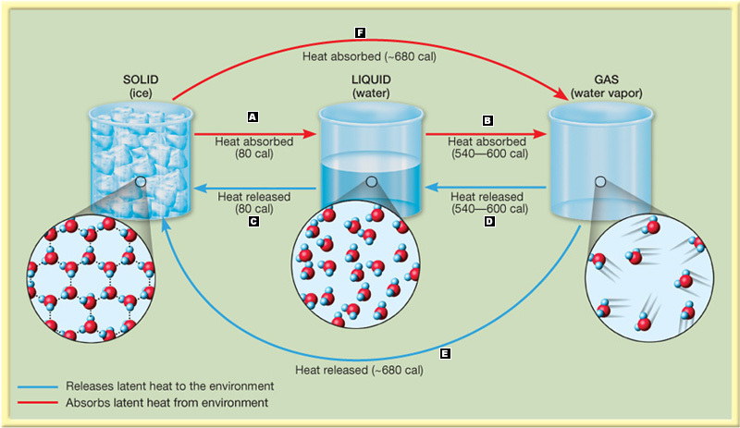
Latent Heat
Notes:
Latent heat diagram: https://wps.prenhall.com/wps/media/tmp/labeling/2131386_dyn.jpg
Latent heat is “hidden” heat energy that changes a substance from one phase to another without changing the temperature of the substance. Some examples of phase changes where latent heat is involved include changing from a solid to a liquid, known as melting, or from a liquid to a gas, known as vaporization. At pressures and temperatures commonly found on earth, groups of water molecules can regularly be found in all three phases - ice, liquid water, and water vapor.
At the surface of the earth, water can evaporate and transpire through vaporization, meaning that a liquid water molecule can absorb enough energy from the substances around it to be able to be released from the molecular bonds with other water molecules and enter into the atmosphere with other gas molecules like nitrogen and oxygen. This can cause localized cooling. The water vapor molecule holds onto that energy until it condenses, at which point it is given to the matter it condenses on as translational energy and chemical bonds. This new movement increases the temperature of the matter that the water vapor condensed on. When that happens in a cloud, it increases the temperature of the cloud and thus increases the amount of radiation given off by that cloud.

Slide 28
Water
Notes:
Water Cycle:
https://www.noaa.gov/sites/default/files/styles/scale_crop_1120x534/public/thumbnails/image/watercycle_rc.png?itok=CcUyhuxd
Latent heat transfer emphasizes even more just how important the water cycle is to energy dynamics on earth. In addition to being a greenhouse gas and moving around latent heat, water in the form of clouds impact albedo and radiation transfers. Oceans absorb CO2. Glaciers melt with increasing temperatures contributing to positive heating feedbacks. Sea levels rise because more water is in the oceans and the oceans are warmer and expanding. It’s all very complicated and interconnected. It requires anyone who is thinking about changing climates to think about whole systems and complex interactions.

Slide 29
Notes:
Earth’s Energy Budget:
https://upload.wikimedia.org/wikipedia/commons/b/bb/The-NASA-Earth%27s-Energy-Budget-Poster-Radiant-Energy-System-satellite-infrared-radiation-fluxes.jpg
And thinking in this way is necessary because it is the only way we can truly understand what’s going on. From a science perspective, we’ve now gone through each of these components of the earth's energy budget and hopefully there is a greater collective understanding of what we mean scientifically when we say climate change.

Slide 30
Climate and Climate Change
Climate: Long-term average of weather Weather: the way the atmosphere is behaving
Temperature
Pressure
Wind
Humidity
Precipitation
Cloudiness
Climate Change: Changes from the long-term average weather
Global Average Temperature Increase = “Global Warming”
Greenhouse gas cycle disruptions contribute
Atmospheric Pressure and Wind are the results of energy balances and distribution
Humidity, Precipitation, & Cloudiness changing
Water cycle (tied to energy dynamics) disruption
Climate change leads to conditions that fundamentally alter life as we know it for ourselves and other systems.
Notes:
Split screen climate change image: https://www.researchgate.net/profile/Muhammad_Saqib_Irshad/post/What_are_the_major_causes_for_climate_change_Serious_replies_please/attachment/5bb0990d3843b006753be32d/AS%3A676494112206848%401538300173076/image/maxresdefault.jpg
Of what’s really going on with the long term averages of temperature, pressure, wind, humidity, precipitation and cloudiness. And how it is fundamentally altering life as we know it.

Slide 31
Climate Change Concepts
Amplification of the Greenhouse Effect
Changes in Energy Distribution
Fundamentals of:
Matter
Energy
Radiation
Convection + Conduction
Latent Heat
NOW WHAT?
Notes:
So, now what. Some people want to use this information to engineer new technologies to control these systems. Others want to figure out how to replicate pieces of these systems so we can live on other planets. Others have decided that the earth will balance herself out without our intervention. Others anticipate the end of the human species.
I think that by understanding these ideas, we can try to undo some of the damage we caused and make better decisions. And, luckily, Cat Buxton is here to share some ideas about how to do that by managing our land and systems differently.

