Slide 1
Updating Zoning Codes to Increase Food Security
Whitney Shields
Center for Agriculture and Food Systems, Vermont Law School
Notes:
Hello! Thank you, Chief Pero. Also, a big thank you to the organizers of this event who have been so adaptable and understanding during this chaotic time.
We are going to shift gears and discuss how a community can include food access in municipal plans and update zoning codes to increase food security. This is an important topic because many municipalities have prohibited people from growing their own food on their property citing public health concerns. However, in the past ten years, we have seen municipalities across the United States begin to include language in their municipal plans around food access as well as amend or update their zoning codes to improve people’s access to healthy foods.

Slide 2
Whitney Shields
Post Graduate Clinical Teaching Fellow
Center for Agriculture and Food Systems, Vermont Law School
Job title
CONTACT ME:
wshields@vermontlaw.edu
2

Slide 3
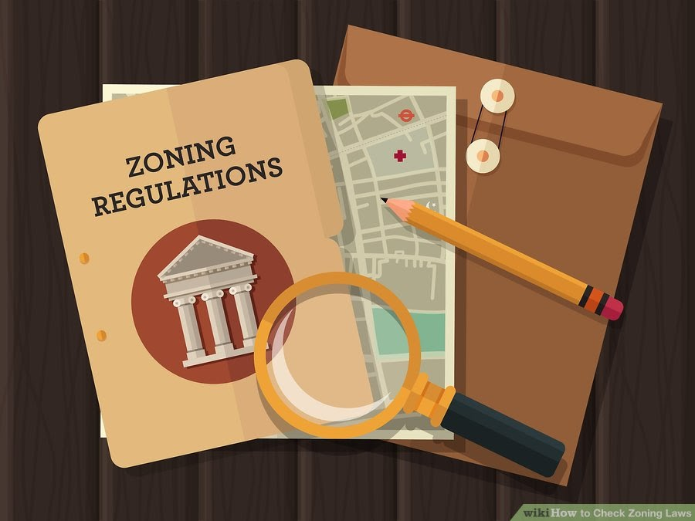
Road Map:
Review planning and zoning and its historical impact on marginalized communities
Share what municipalities are doing to improve food access
Opportunities in Vermont
Conclusion
@CAFScenter
www.vermontlaw.edu/cafs
3
Notes:
During this presentation I will discuss the following items:
My goals are to:
Provide comprehensive information about municipal authority with a specific focus on zoning and planning;
Share national and local examples to encourage methods of implementing similar plans in your community;
Look at another way to strengthen our local food system through law and policy.

Slide 4
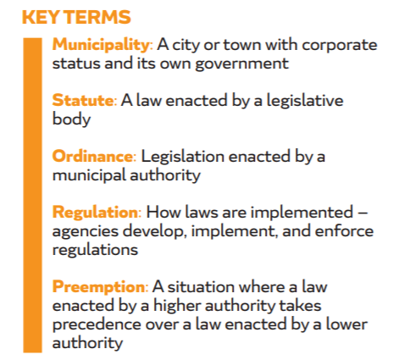
Food production
Image: https://www.chlpi.org/wp-content/uploads/2013/12/good-food-good-laws_toolkit-10.23.2017.pdf
@CAFScenter
www.vermontlaw.edu/cafs
4
Notes:
To begin with, I would like to do a quick overview of the authority given to municipalities:
Municipalities may pass laws and regulations when they are authorized by the state government to do so. In fact, local governments often pass more stringent requirements than state law (for example: hunting and fishing regulations). Zoning and land use law are primarily state and local matters. However, fed law can limit state and local gov land use regs in some instances. (takings clause)

Slide 5
Municipal Plans
Food access
Image: Agency of Commerce and Community Development
@CAFScenter
www.vermontlaw.edu/cafs
5
Notes:
A master plan, or comprehensive plan, is developed by a community to conceptualize their long-term goals for the future development of their community. It provides research, community input, land use recommendations, and analysis.

Slide 6
Zoning
Food access
Image: https://www.chlpi.org/wp-content/uploads/2013/12/good-food-good-laws_toolkit-10.23.2017.pdf
@CAFScenter
www.vermontlaw.edu/cafs
6
Notes:
Zoning is a regulatory tool that municipalities can use to implement their plan as well as determine land use. Separating land into zones prevents nuisances and allows municipalities to have more control when regulating different types of land use. Most zoning takes place at the city or town level, but county or regional laws may also regulate some of the same uses. Historically, zoning has been focused on separating uses of land that were deemed incompatible, such as urban land use from agricultural use.

Slide 7
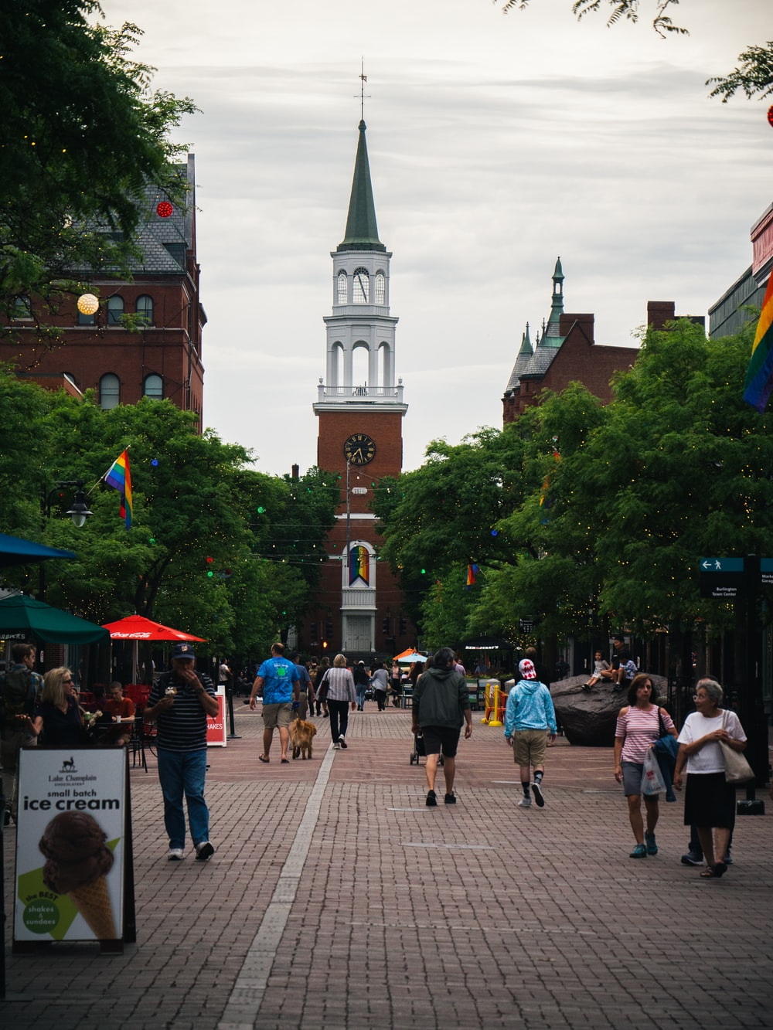
Zoning and Agriculture
Food access
Unfortunately, zoning codes frequently restrict or prohibit agricultural activities, especially in residentially zoned areas which decreases people's autonomy to grow their own food.
Image: https://unsplash.com/photos/PFhr2ppR9mY
@CAFScenter
www.vermontlaw.edu/cafs
7
Notes:
In regard to agriculture use, rural localities may worry that zoning may restrict agricultural productivity and reject zoning altogether. Urban areas are now more often being planned with mixed-use zoning in order to integrate commercial, residential, institutional, and agricultural uses.

Slide 8
Zoning’s Impact on Marginalized Communities
Food access
Image: https://www.theguardian.com/cities/2018/feb/21/roads-nowhere-infrastructure-american-inequality
@CAFScenter
www.vermontlaw.edu/cafs
8
Notes:
Historical local land use planning and zoning has created issues in the areas of environmental justice and food access.
On the environmental end:
For many years, federal policies reinforced local practices that limited housing for African-Americans to less desirable areas adjacent to factories. Federally-insured mortgages provided by the Federal Housing Authority shaped exclusionary practices by subsidizing the suburbs at the expense of American’s urban areas, thus proliferating race-based housing policies that continued well into the 1960s, and some would argue even today. Federal highway projects as well as urban renewal policies have often displaced and segregated African-Americans into limited areas.
Image: This is Hastings St. which used to be the main thoroughfare in Detroit’s historic African American neighborhood, Black Bottom.

Slide 9
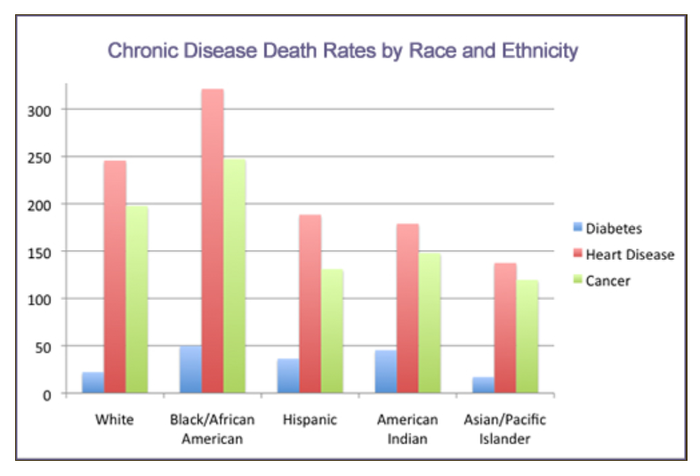
Zoning’s Impact on Marginalized Communities
Food access
Image: https://www.patientnavigatortraining.org/chronic_disease/module1/2_healthdisparityexamples.htm
@CAFScenter
www.vermontlaw.edu/cafs
9
Notes:
In regard to food access:
This has also impacted marginalized communities' access to healthy foods. For example, large grocery stores do not open their businesses in marginalized communities because they seek out areas close to high-paying clientelle. Therefore, many of these communities only have fast food, Dollar Stores, and convenient stores which sell highly processed foods. This has caused a huge spike in diet-related illnesses, especially in communities of color.

Slide 10
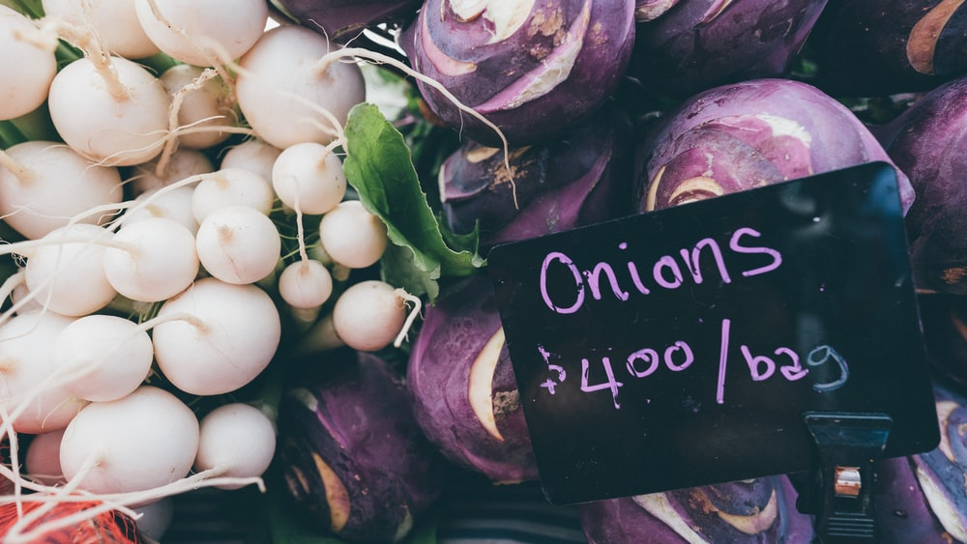
Tools to Remove Zoning Barriers
Food accessProvieP
Provide clarity on agricultural terms
Specify which zones allow agriculture
Allow on-site sale of produce whenever possible
Allow for small-animal husbandry
Image: https://unsplash.com/photos/zijpPEZvyXk
@CAFScenter
www.vermontlaw.edu/cafs
10
Notes:
Updating zoning codes to minimize limitations on agricultural uses has the potential to increase residents’ access to healthy food. Allowing residents to grow their own food or encouraging small growers to produce food in food-insecure areas can increase access to healthy food. By ensuring that food production is properly regulated and managed, local governments can create a mixed-use land pattern that incentivizes healthy food production in all zones while ensuring community concerns and quality of life issues are addressed.

Slide 11
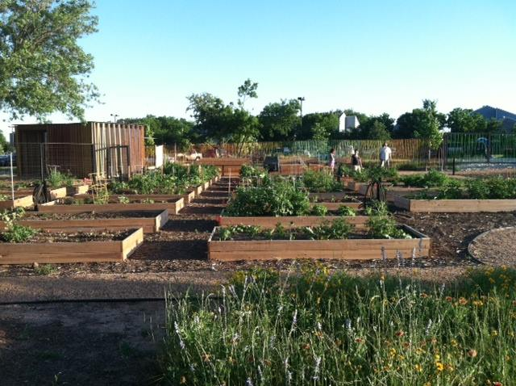
Tools to Remove Zoning Barriers: Provide clarity on agricultural terms
Food accessProvieP
Austin, Texas:
Updated their ordinance to define various agricultural uses including aquaponics, horticulture and indoor crop rotation.
North Austin Community Garden
Image: http://www.austintexas.gov/blog/north-austin-community-garden-bringing-residents-together-art-dirt-and-tools
@CAFScenter
www.vermontlaw.edu/cafs
11
Notes:
Without clear definitions, zoning codes may discourage food production through ambiguous language and unclear regulations. Potential growers may have a difficult time discerning what is allowed and refrain from producing food due to fear of a possible violation or fine.

Slide 12
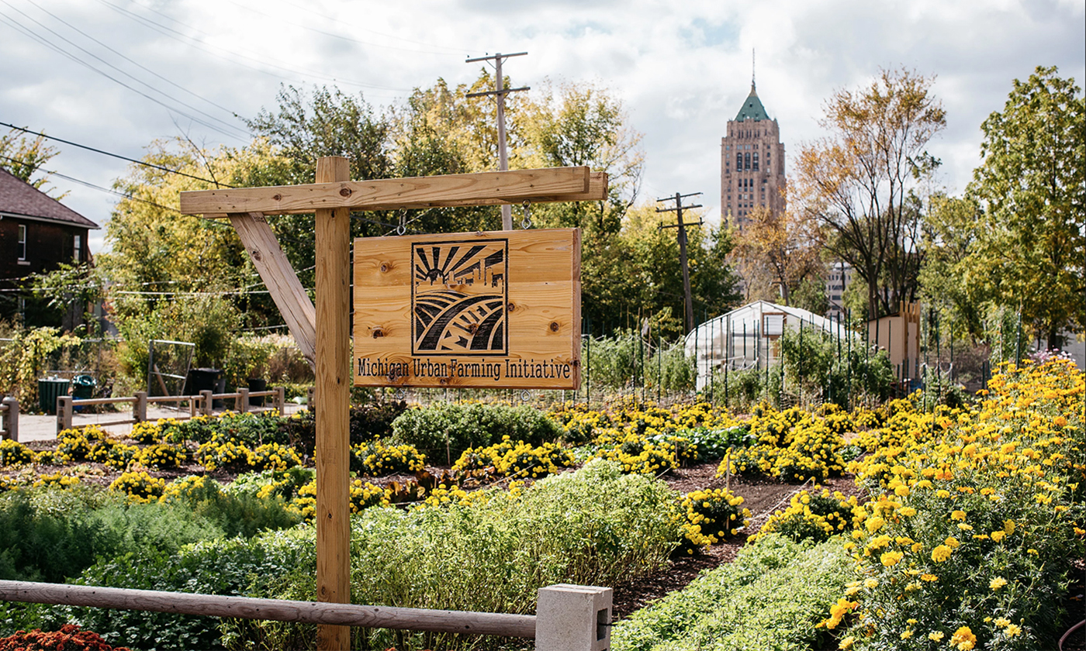
Tools to Remove Zoning Barriers: Specify which zones allow agriculture
Food accessProvieP
Detroit, Michigan
Detroit’s ordinance includes agriculture terms and where agriculture is permitted.
Michigan Urban Farming Initiative
Image: https://www.yesmagazine.org/social-justice/2019/11/05/food-community-detroit-garden-agriculture/
@CAFScenter
www.vermontlaw.edu/cafs
12
Notes:
If land use is not spelled out, growers may be hesitant to invest long-term or even start growing as they may feel they can be ordered to stop growing at any time. Naming the urban agriculture as a permitted land use gives more permanence and authority to growers.

Slide 13
Tools to Remove Zoning Barriers: Allow on-site sale of produce
Food accessProvieP
Cedar Rapids, Iowa
Cedar Rapids municipal code specific which products are allowed to be sold at a farm stand.
@CAFScenter
www.vermontlaw.edu/cafs
13
Notes:
Some zoning codes may not allow on-site sale of produce, which limits the ability for growers to sell produce with their neighbors and other consumers. Specifically permitting on-site sale of farm products can increase access to healthy food to neighborhood consumers.

Slide 14
Tools to Remove Zoning Barriers: Allow for small-animal husbandry
Food accessProvieP
Boston, Massachusetts
Boston’s zoning code sets provisions for keeping hens, bees including use regulations, size and animal limitations.
Image: https://www.bostonglobe.com/news/nation/2017/10/19/the-all-too-real-perils-backyard-chickens/yLlrlwAETDIuht4shOurPK/story.html
@CAFScenter
www.vermontlaw.edu/cafs
14
Notes:
Restrictions on keeping animals can limit residents from producing additional food besides fruits and vegetables. Products like milk, eggs and honey may be hard for consumers to find locally especially in areas without access to fresh and affordable food.
Prohibiting animal-keeping can also disproportionately affect immigrant communities. For example, Muslim communities expressed a desire to produce Halal meats in Detroit but community opposition to allowing animals in city limits means this is still not allowed in the zoning code.

Slide 15
Vermont
Food accessProvieP
Planning in Vermont:
11 planning regions
Each region has a regional plan
Municipal plans are optional
Municipal plans feed into regional plans which help feed into state agency plans
Types of Food Access Plan:
Create a food access plan in an existing plan
Create an independent food access plan
@CAFScenter
www.vermontlaw.edu/cafs
15
Notes:
In Vermont, the state has given authority to municipalities to develop zoning by-laws which they can elect to implement or not (Zoning statute: 24 VSA 3028 (a); land use statute: Act 250).
11 planning regions: each region has a regional planning commission with a board of directors
Each region has a regional plan
Municipal plans are optional: but having an approved plan allows municipalities to participate in certain state and federal programs and access to funding sources
Municipal plans feed into regional plans which help feed into state agency plans: on topics as diverse as water quality, housing, and hazard mitigation

Slide 16
Vermont: Case Studies
Washington County:
Hunger Free VT’s Council of Washington County and the Central Vermont Regional
Planning Commission developed a mapping toll to identify food access barriers for
community members. The goal was to identify potential opportunities to increase food
access.
Calais:
Developed a self-sufficiency plan to increase “an interest in growing and processing our
own food to move towards food independence.”
St. Albans:
2017 City Plan refers to healthy food access.
Food accessPrviePW
@CAFScenter
www.vermontlaw.edu/cafs
16
Notes:
These case studies were included in Farm to Plate’s Local Planning Resource which I will share at end of this presentation.
CALLUS ON MY THUMB!

Slide 17
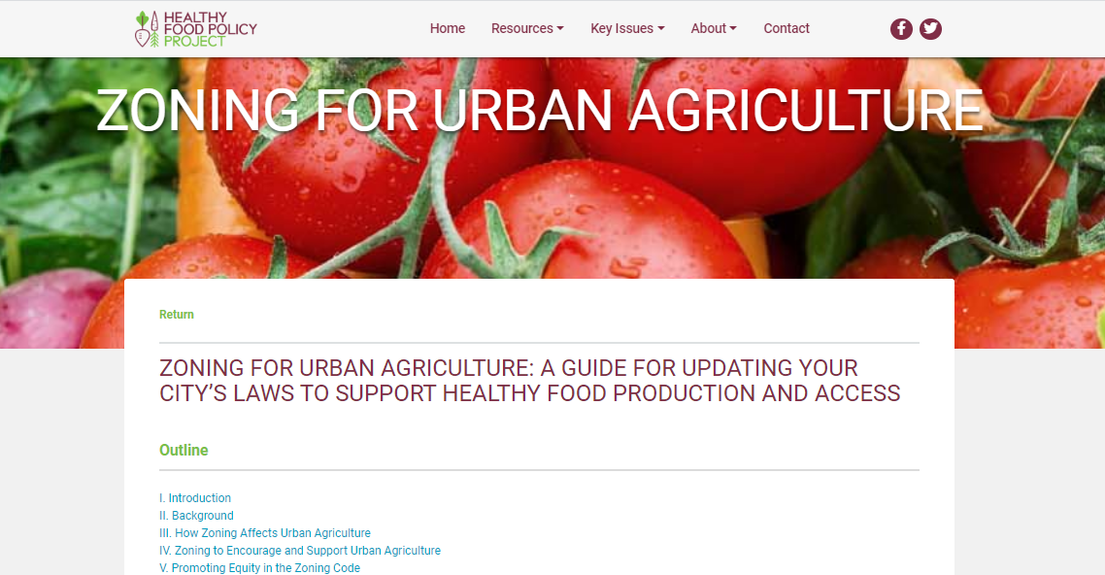
Healthy Food Policy Project
Food accessPrviePW
@CAFScenter
www.vermontlaw.edu/cafs
17
Notes:
For more information about updating or amending zoning codes, please visit the Healthy Food Policy Project. HFPP is a partnership between CAFS at VLS, Rudd at the University of Connecticut, and Public Health Law Center. HFPP identify and elevate local laws that seek to promote access to healthy food while also contributing to strong local economies, an improved environment, and health equity, with a focus on socially disadvantaged and marginalized groups.
A special shout out to Tess Romanski, a Master’s student at Vermont Law School who developed the HFPP resource pictured here.

Slide 18
Healthy Food Policy Project
Zoning for Urban Agriculture: A Guide for Updating Your City’s Laws to Support Healthy Food Production and Access
Farm to Plate
Local Planning for Food Access: A Toolkit for Vermont’s Communities
Harvard Law School Food Law and Policy Clinic
Good Laws Good Food: Putting Local Food Policy to Work for Our Communities
EPA: Environmental Justice
How Planning and Zoning Contribute to Inequitable Development, neighborhood Healthy, and Environmental Injustice
EPA: National Academy of Public Administration
Addressing Community Concerns: How Environmental Justice Relates to Land Use Planning and Zoning
Resources
18
Notes:
I want to point out two specific resources: The Healthy Food Policy Project and the Farm to plate resource on local planning. These two resources have a variety of information around local planning and examples of innovative local policies.

Slide 19
Learn more
and get in touch:
@CAFScenter
19
Notes:
I hope that this presentation:
Provided comprehensive information about municipal authority with a specific focus on zoning and planning;
Shared national and local examples to encourage methods of implementing similar plans in your community;
Looked at another way to strengthen our local food system through law and policy.

